Slide 1
InflamEase App
Hamza(8628)
Abdullah(8380)
Notes:
Title slide — generated from uploaded docx and project files.

Slide 2
Contents
Introduction & Problem Statement
Core Features & MVP
Data Model & API Overview
Technical Architecture & Tech Stack
UML (Use Case / Class / Activity)
Prototype / Screenshots
Privacy & Compliance
Roadmap & Next Steps
Q&A
Notes:
Contents — follow this order when presenting.

Slide 3
Introduction
From: Abdulrehman
Date: December 18, 2025
Introduction & Vision
We are seeking to develop "InflamEase," a dedicated mobile application designed to empower individuals living with chronic inflammatory conditions.
Our vision is to create an intuitive, all-in-one tool that helps users track, understand, and manage their health by making informed dietary and lifestyle choices.
The app will serve as a personal companion for anyone looking to reduce inflammation and improve their quality of life.
Notes:
Use this slide to set the stage — pain, solution, users.

Slide 4
Core Features & MVP
Authentication & Onboarding (profile, conditions)
Daily Health Diary (meals, symptoms, photos)
Flare Logging (severity, duration, triggers)
Recipe Hub (searchable, save & grocery list)
Basic Insights (correlations, trends)
Notes:
Prioritize low-friction logging and actionable insights for MVP.

Slide 5
Data Model (high-level)
User, DiaryEntry, Food, Recipe, Flare, Supplement, GroceryList, Insight
Store foods and recipes with tags (anti-inflammatory score)
Diary entries reference foods and optionally photos/notes
Insights stored as JSON with confidence score
Notes:
This slide gives engineers a quick map of core entities.

Slide 6
API Examples
POST /api/auth/signup — register user (returns JWT)
POST /api/diary — add diary entry (foods, notes, photo_url)
POST /api/flares — log flare (severity, triggers)
GET /api/insights — fetch computed insights for user
Notes:
Use REST for MVP; consider GraphQL later if needed.

Slide 7
Technical Architecture & Tech Stack
Frontend: React Native + Expo (TypeScript)
Backend: Next.js API routes or Node + Express + Prisma
DB: PostgreSQL (Prisma ORM); Storage: S3-compatible
Auth: Clerk/Auth0 or JWT; Hosting: Vercel / Render / Railway
CI/CD: GitHub Actions; Builds: EAS for mobile
  Top-level repo entries: .env.example, .gitignore, app, app.json, assets
Notes:
Recommend starting with managed services to reduce ops burden.

Slide 8
Insights & ML Approach
Phase 1: Statistical correlations (counts, moving averages)
Phase 2: Simple per-user models (logistic regression / tree)
Always present correlation (not causation) with confidence
Require weeks/months of data — provide cohort-level signals initially
Notes:
Keep models explainable and conservative in claims.

Slide 9
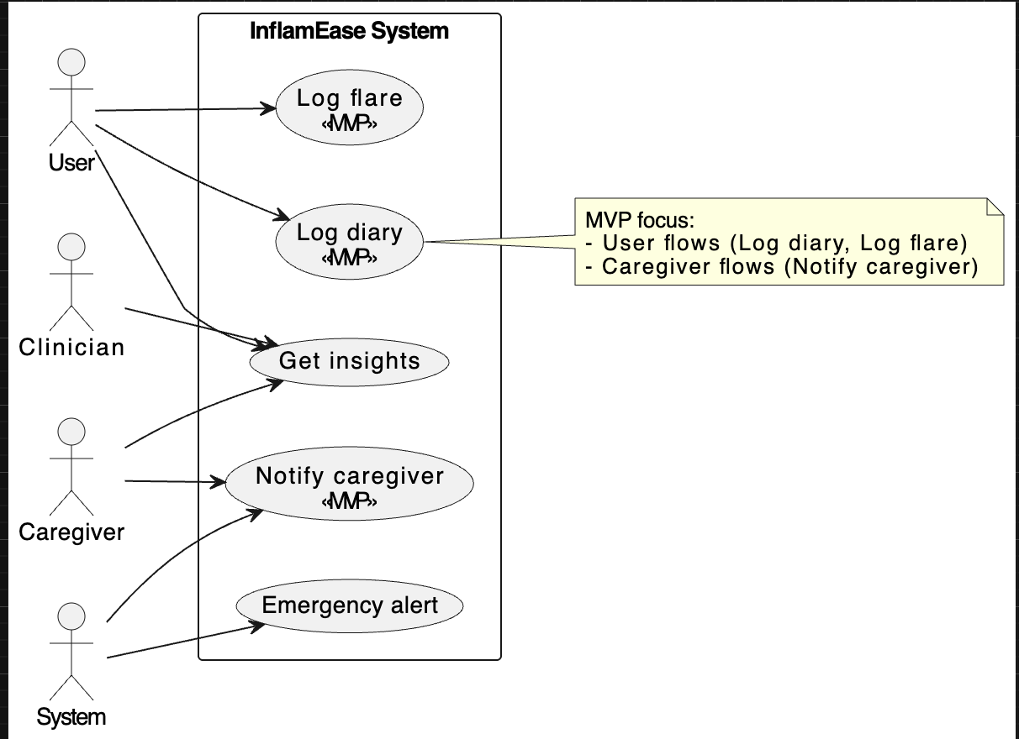
UML — Use Case (summary)
Notes:
If you want, I can generate PNG UML diagrams and add them to the PPT.

Slide 10
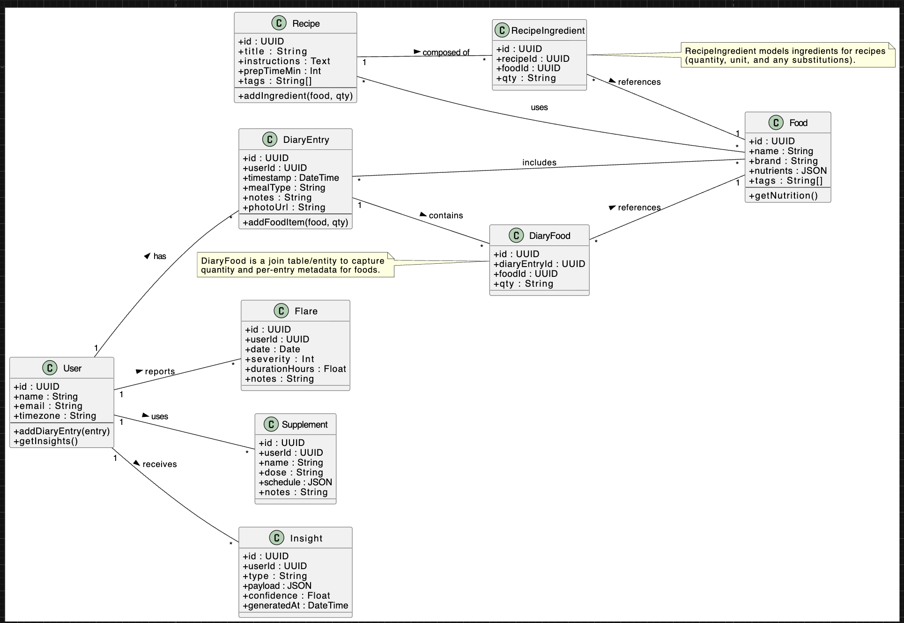
UML — Class Diagram (summary)
Notes:
Class diagram here is intentionally high-level for discussion.

Slide 11
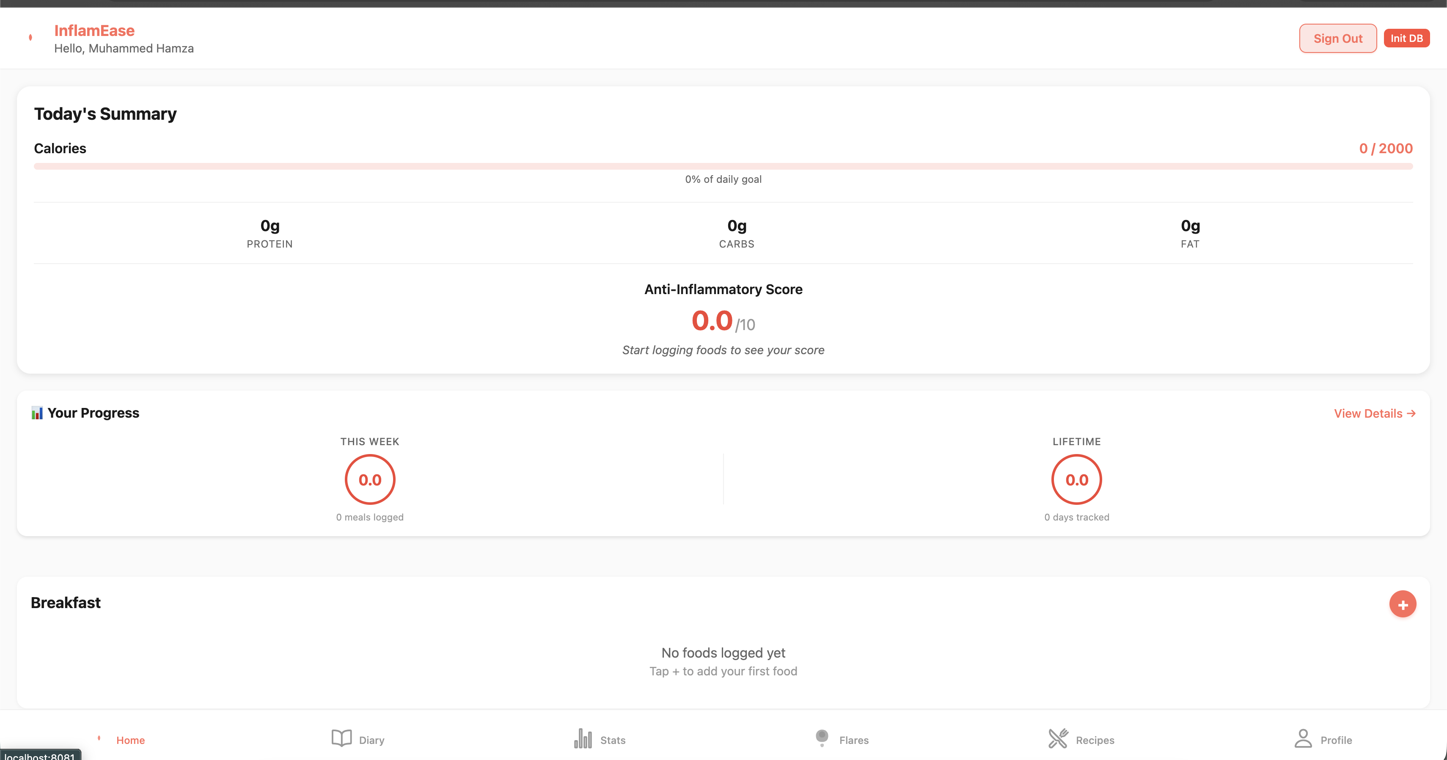
Prototype / Home

Slide 12
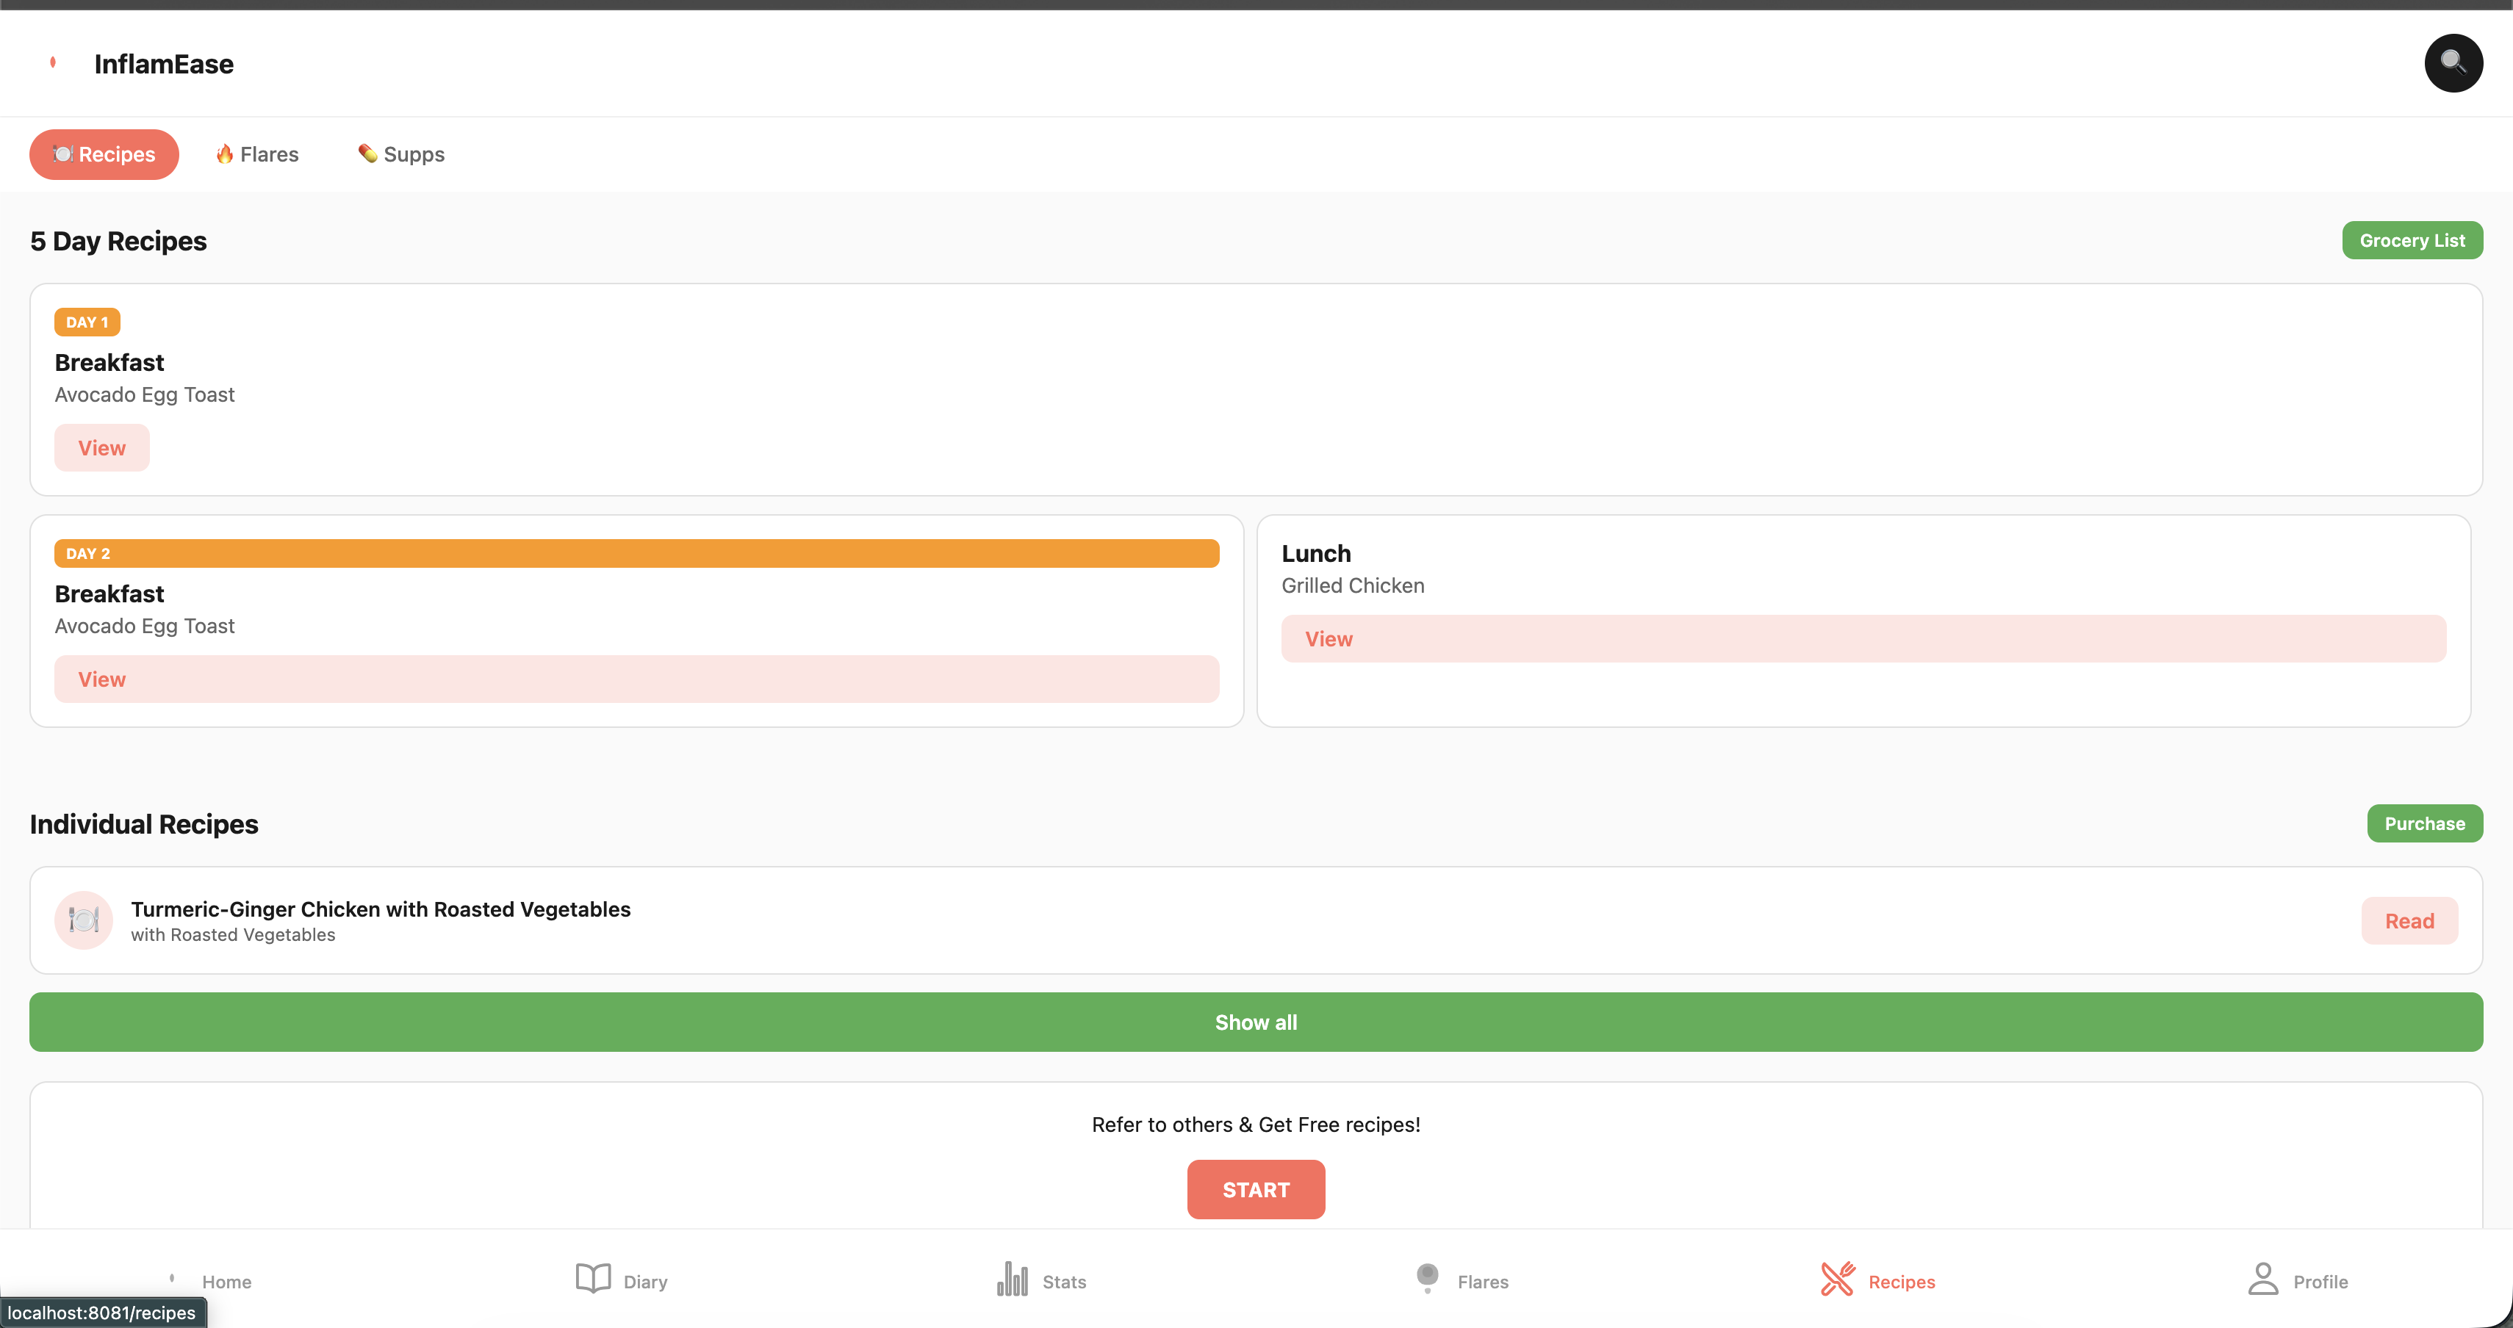
Prototype / Recipes
Notes:
Replace placeholder with real images for demo.

Slide 13
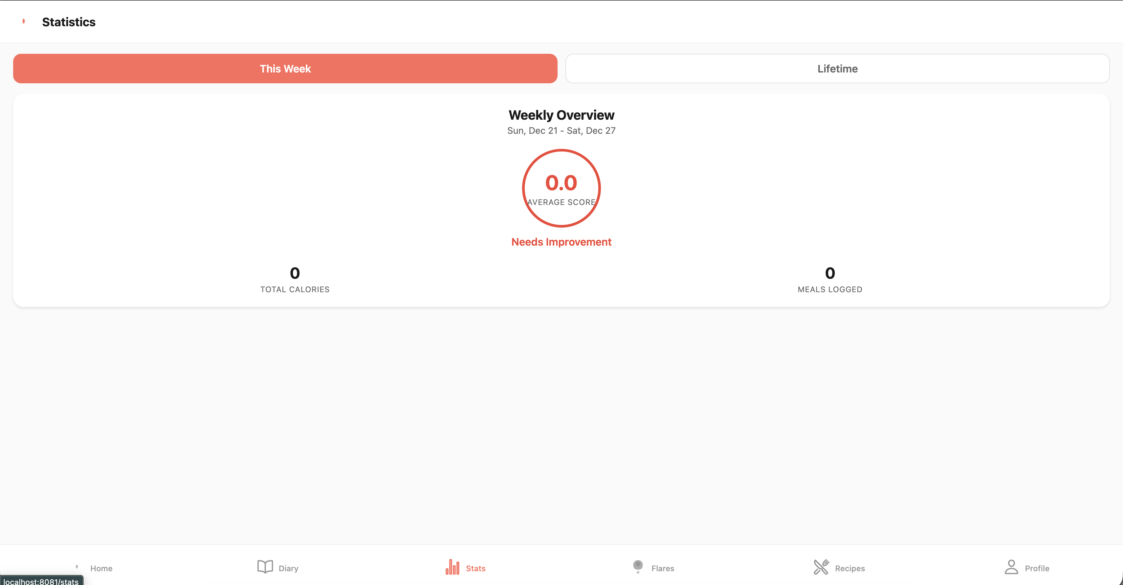
Prototype/ Stats

Slide 14
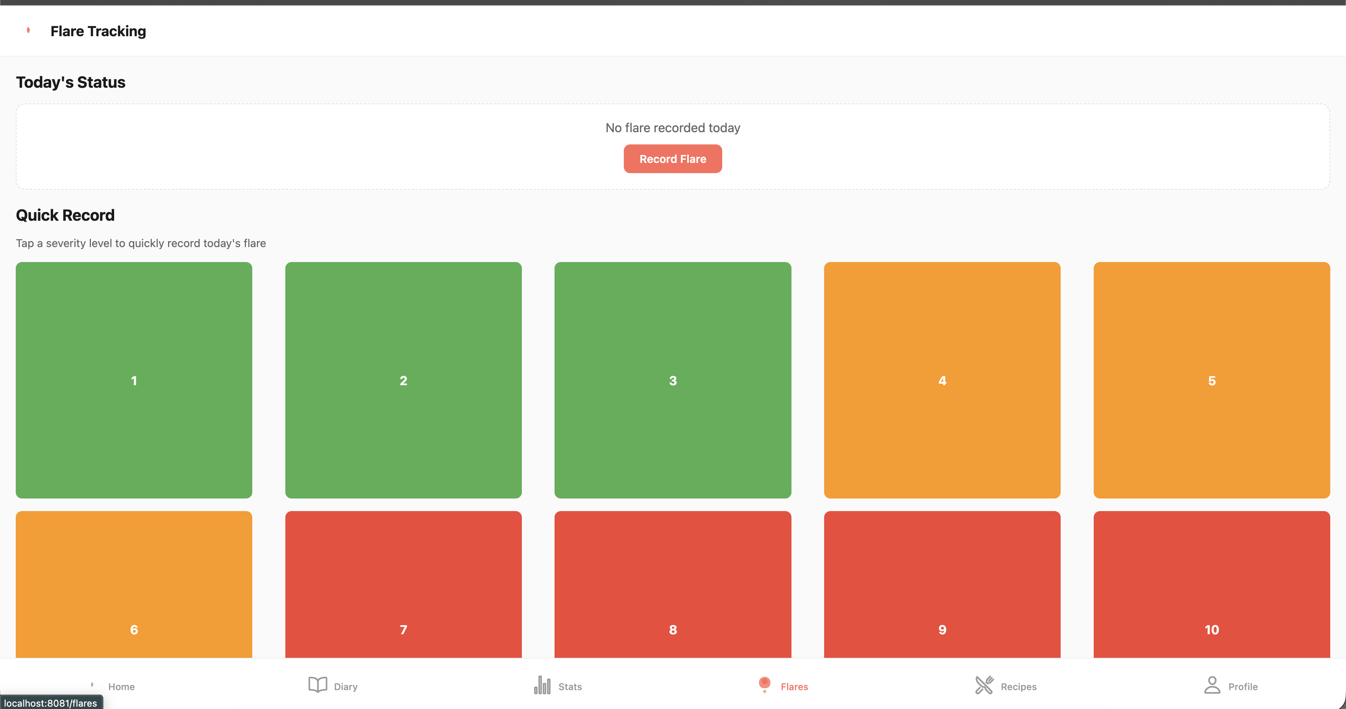
Prototype/ Flares

Slide 15
Q&A / Contact
Thank you — questions?
Contact: (add your email)
Repository & files used: uploaded ZIP and docx.
Notes:
End of presentation.

